Slide 1
My motherland - Cheboksary
The Bonch-Bruevich Saint Petersburg State University of Telecommunications
Performed by Kostrov Dmitrii, 1st year student, bachelor, faculty of Software engineering.
Advisor Elena Petrovna, Associate Professor, Candidate of Pedagogical Sciences
St. Petersburg, 2024

Slide 2
Contents
1.
2.
3.
4.
5.
6.
7.
My motherland – Cheboksary
Contents
Mother Patroness Monument
Victory Park
Cheboksary International Airport
Beer museum
The elder of the Chuvash oak forests

Slide 3
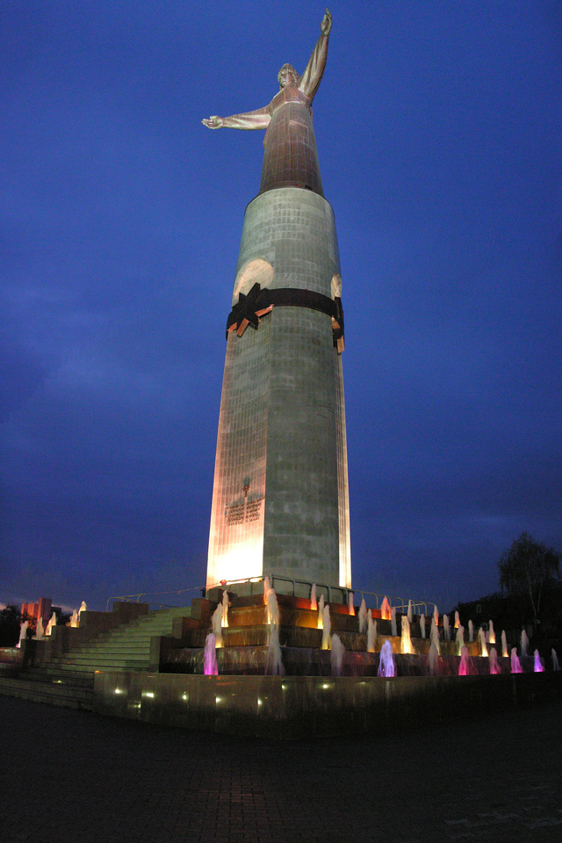
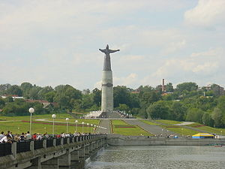
Mother Patroness Monument
Was opened on 9 May 2003.
Sculptor -Vladimir Nagornov.
The monument from afar
The Monument by night

Slide 4
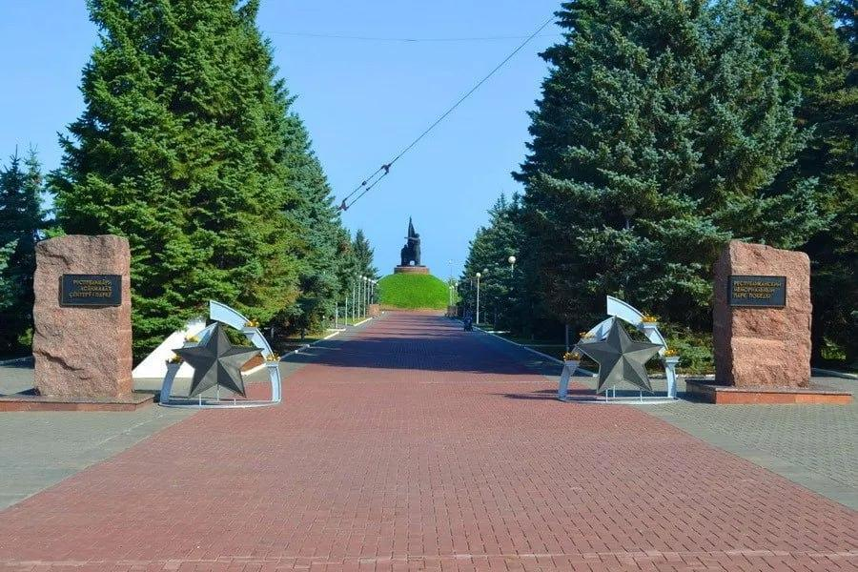
Victory Park
Monument of Military Glory with the Eternal Flame
Monument to the soldiers who died in Chechnya.
St. John the Warrior.
Monument to the liquidators of the Chernobyl accident.
Monument to soldiers who died in Afghanistan.
Cascade Fountain and the Alley of Heroes.
Museum of Military Equipment
Victory Park

Slide 5
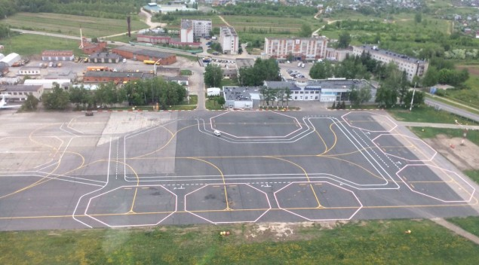
Cheboksary International Airport
Airlines | Destinations
Aeroflot | Moscow–Sheremetyevo
Azimuth | Mineralnye Vody, Surgut
Ikar | Seasonal: Kaliningrad (begins 1 May 2025)
Nordwind Airlines | Sochi
Pobeda | Moscow–Sheremetyevo, Saint Petersburg; Seasonal: Sochi
UVT Aero | Nizhnevartovsk; Seasonal: Surgut
Cheboksary International Airport
Airlines and destinations

Slide 6
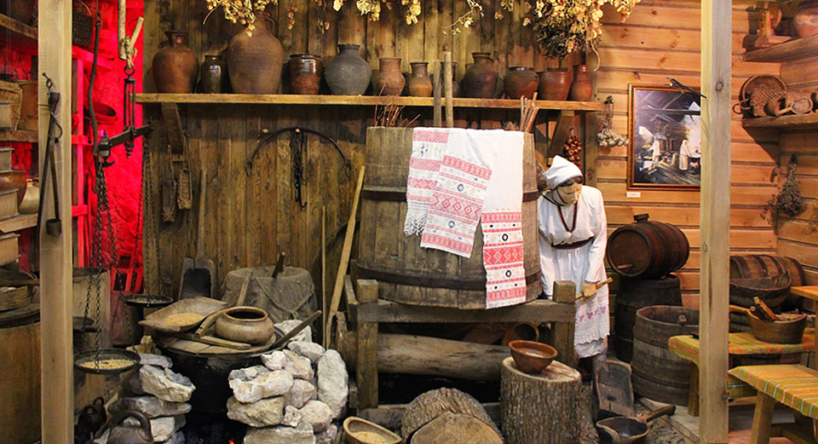
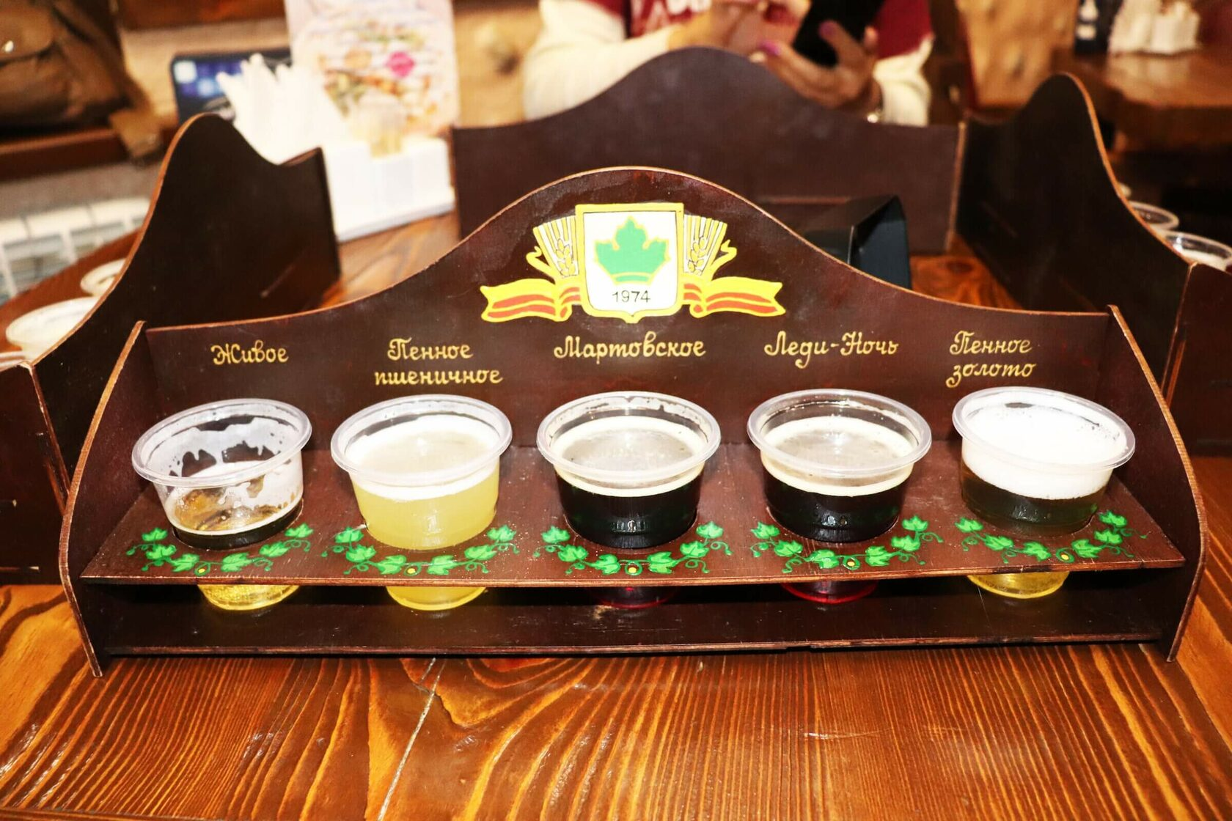
Beer museum
Opened in 1997.
Renovated in 2005.
Chuvash Hall
Degustation set

Slide 7
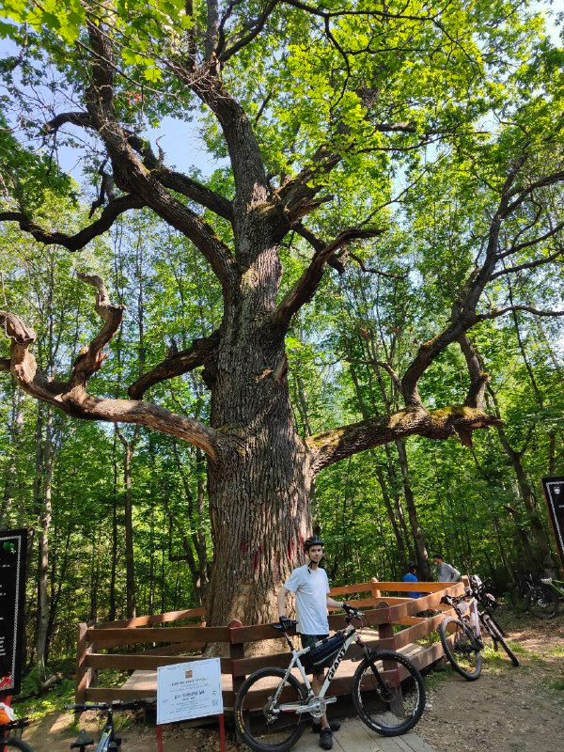
The elder of the Chuvash oak forests
Was born in 1651.
Was opened in 1996.
The trunk diameter is 182 cm.
Circumference — 570 cm.
Height is 26 meters.
Oak in 2024

